Slide 1
Banyan Tree
Embracing the Environment, Empowering People
Tanya MacLaurin, Michael Chiam Kah Min

Slide 2
Learning Outcomes
After completing this case study, learners should be able to:
define entrepreneurship and discuss its role in the sustainable development at Bang Tao Bay;
list and explain sustainable practices taken by Banyan Tree at the micro, meso and macro levels of the Laguna Phuket development at Bang Tao Bay;
discuss the relationship of Banyan Tree's core values with their co-founders, Mr Ho Kwon-Ping and Ms Claire Chiang;
describe the role of strategic sustainable development decision making at the Bang Tao Bay development;
list best practices developed at Laguna Phuket and discuss how they have impacted future Banyan Tree developments; and
define corporate social responsibility and corporate shared value. Discuss their impact

Slide 3

Background
Banyan Tree Hotels and Resorts (commonly known as "Banyan Tree")
is a subsidiary of Banyan Tree Holdings Limited with their corporate
office in Singapore.
Many prestige awards and accolades have been received for their leadership in sustainable practices.
  World Travel and Tourism Council’s “Tourism for Tomorrow Award 2012” recognized Banyan Tree for their achievement as pioneers in sustainable tourism development.
Founded on the core value of driving sustainable development, Banyan Tree seeks to be an agent of social and economic development through responsible tourism.
This case presents information on the environmental initiatives implemented at their first integrated resort in Asia, the Laguna Phuket, under the visionary guidance of their Executive Chairman, Mr. Ho Kwon-Ping.

Slide 4
Background

Slide 5
Purpose of the Case
To provide a platform for developing an understanding of entrepreneurial strategic sustainable development in the hotel industry utilizing the concepts of core values, corporate social responsibility and corporate shared value as demonstrated by Banyan Tree's development activities at Bang Tao Bay - Laguna Phuket.

Slide 6
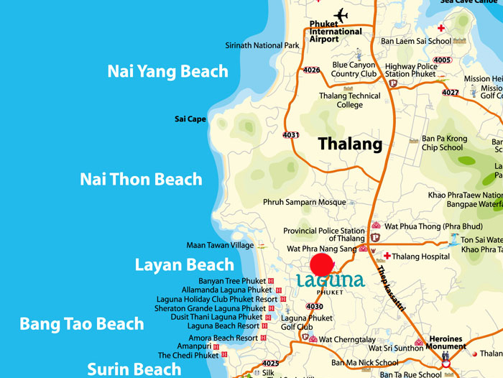
Laguna Phuket

Slide 7
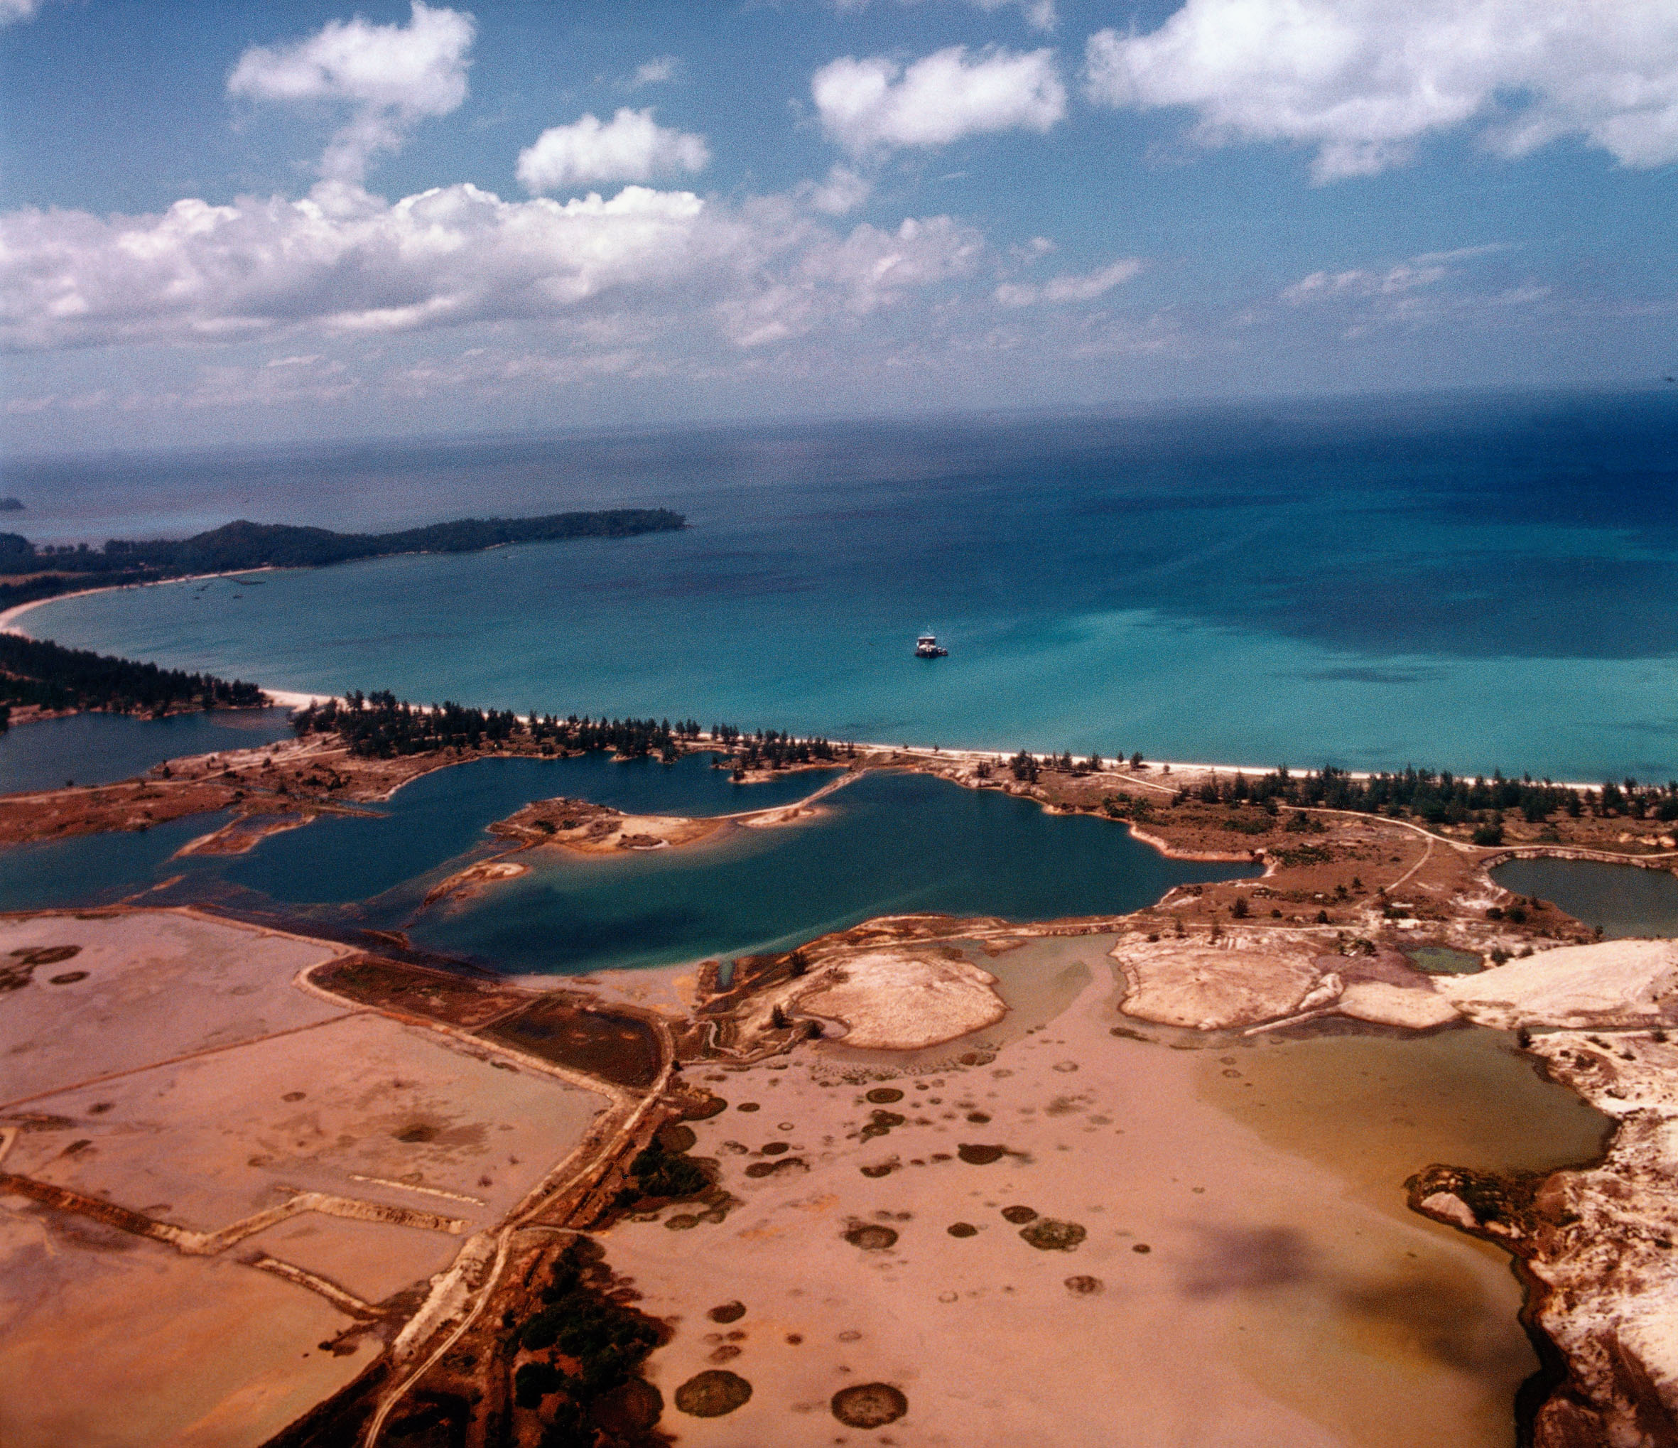
Bang Tao Bay, Phuket, Thailand

Slide 8
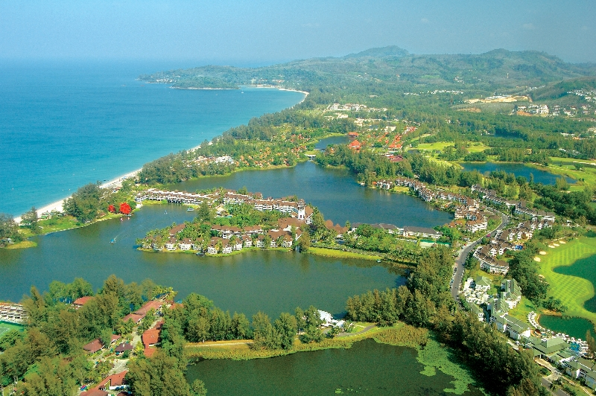
Laguna Phuket

Slide 9
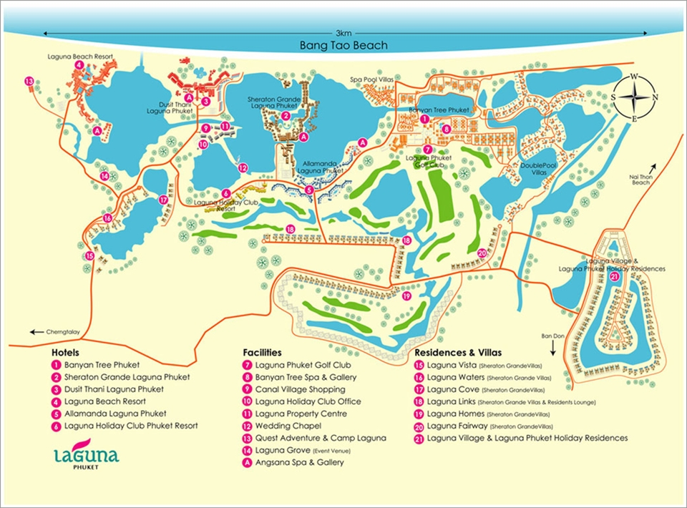

Slide 10
Key Concepts
Entrepreneurship
Core Values
Corporate Social Responsibility
Corporate Shared Value

Slide 11
Conclusions
Core values drive the activities of a business.
Core values must be passionately espoused by a human champion.
Corporate social responsibility and shared value enable a business to deliver on their goal of sustainability.

Slide 12
Study Questions
Outline and discuss the impacts of entrepreneurial strategic decision making and the core values of Executive Chairman, Mr Ho Kwon-Ping on the sustainable development of Bang Tao Bay - Laguna Phuket.
List and discuss how Banyan Tree builds and maintains value for its customers with their sustainable hotels and resorts.
List the sustainable best practices developed and implemented by Banyan Tree. Discuss why these best practices work well for Banyan Tree and why they may or may not work for other hotel companies.
Many of Banyan Tree’s properties are luxury resorts. Analyse whether sustainability and luxury can coexist.
Describe whether Banyan Tree's corporate social responsibility programs demonstrate Porter & Kramer's concept of shared value.

